Slide 1
Network Troubleshooting
K.P.I. Shenesh Perera
IDM

Slide 2
Hardware based issues in a network
Hardware troubleshooting is the process of reviewing, diagnosing and identifying operational or technical problems within a hardware device or equipment.
It aims to resolve physical and/or logical problems and issues within a computing hardware.
This type of problem usually results in delays, timeouts or simply just no response in a network.
Often these issues are jumbled with software problems and are take.
Hardware problems take the longest time to troubleshoot and usually require replacement or repairing that costs money.

Slide 3
General tips to troubleshoot hardware issues
Removing, repairing and replacing faulty RAM, hard disk or video/graphic card.
Cleaning dusts from RAM and Video carts slot/ports and from cooling fan.
Tightening cable and jumpers on motherboard and/or components.
Software related hardware problems such as device driver update or installation.

Slide 4
Cable Problems
Cables that connect different parts of a network can be cut or severely damaged.
A short circuiting can happen when the wire conductor comes in contact with another conductive surface, changing the path of the signal.
Cable testers can be used to test for many types of cable problems such as: Cut cable, incorrect cable connections, Cable shorts, Interference level, Connector Problems
This is usually the most common problem but is quite the task to discover in a large network.

Slide 5
Connectivity problems
A connectivity problem with one or more devices in a network can occur after a change is made in configuration or by a malfunction of a connectivity component, such as hub, a router or a Switch.
As such there are devices like routers and switches are often placed in rack mounts with patch panels set plugged in with keystones so that during maintenance of the devices the device itself doesn’t get harmed.

Slide 6
Excessive Network Collisions
These often lead to slow connectivity.
The problem can occur as a result of bad network setup/plan, a user transferring a lot of information or jabbering network card.
A jabbering Network card is a network card that is stuck in a transmit mode.
This will be evident because the transmit light will remain on constantly, indicating that the Network card is always transmitting.

Slide 7
Software based issues in a network
There are multiple ways to fix software issues and identify them, simply because there are so many software issues in a network.
Usually if after troubleshooting all the hardware problems that could possibly exist, then it is advised to move towards using troubleshooting methods to identify software problems.

Slide 8
Ping tests
The most commonly used network tool is the ping utility. This utility is used to provide a basic connectivity test between the requesting host and a destination host.
This is done by using the Internet Control Message Protocol (ICMP) which has the ability to send an echo packet to a destination host and a mechanism to listen for a response from this host.
This utility is commonly used to provide a basic picture of where a specific networking problem may exist.
Notes:
For example, if an Internet connection is down at an office, the ping utility can be used to figure out whether the problem exists within the office or within the network of the Internet provider.

Slide 9
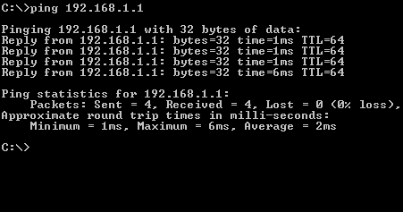
Figure 1.0

Slide 10
Trace route testing
Typically, once the ping utility has been used to determine basic connectivity.
The tracert / traceroute utility can used to determine more specific information about the path to the destination host including the route the packet takes and the response time of these intermediate hosts.
The tracert utility and traceroute utilities perform the same function but operate on different operating systems, Tracert for Windows machines and traceroute for GNU/Linux based machines.

Slide 11
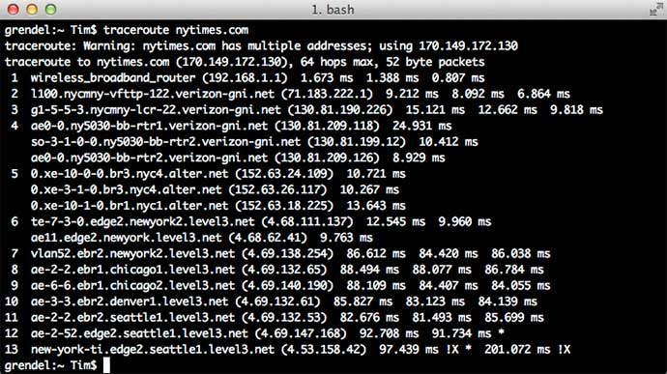
Figure 1.1, kidscodecs.com, TIM SLAVIN, 15/05/2014

Slide 12
Using NSlookup to troubleshoot DNS problems
Some of the most common networking issues revolve around issues with Dynamic Name System (DNS) address resolution issues.
When this system does not work, most of the functionality that people are used to goes away, as there is no way to resolve this information.
The nslookup utility can be used to lookup the specific IP address associated with a domain name. If this utility is unable to resolve this information, there is a DNS issue.
Notes:
Along with simple lookup, the nslookup utility is able to query specific DNS servers to determine an issue with the default DNS servers configured on a host.

Slide 13
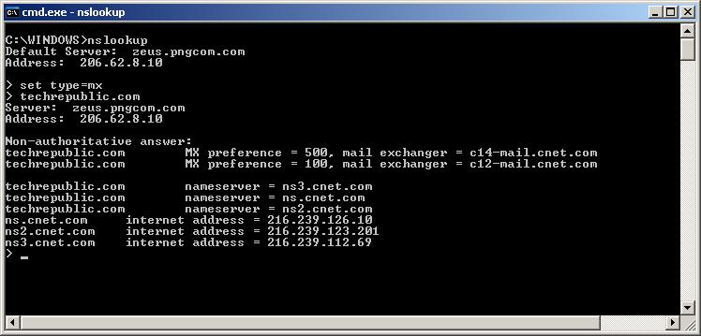
Figure 1.3, techrepublic.com, Cara Reynolds, 28/08/2006

Slide 14
Network Error Codes
Commonly, error codes occur when the network is often connected to the internet.
Each particular set of error codes have their own implication as to what the problem is, this could give us insight on what we should do to fix the problem. The upcoming slides will explain some of the common error codes.
Below is a general description of errors in a network;
1xx: Informational
2xx: Success
3xx: Redirection
4xx: Client Error
5xx: Server Error
Notes:
Visit here: https://docs.microsoft.com/en-us/windows/desktop/netmgmt/network-management-error-codes for a full list of error codes in a windows network environment

Slide 15
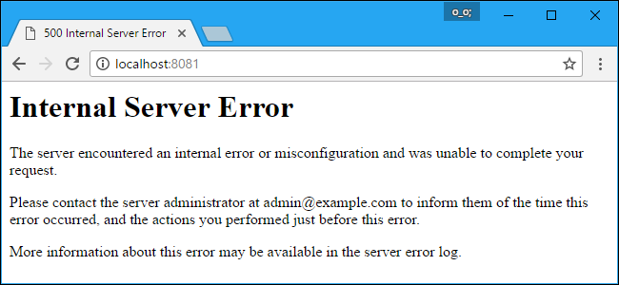
500: Internal Server Error
Internal Server Error, means that server cannot process the request for an unknown reason.
Sometimes this code will appear when more specific 5xx errors are more appropriate.
This most common cause for this error is server misconfiguration or missing packages
Figure 1.4, howtogeek.com, Chris Hoffman, 08/05/2017
Notes:
This error may appear in a variety of different ways, but they all mean the same thing. Depending on the website, you may see the message “500 Internal Server Error”, “500 Error”, “HTTP Error 500”, “500. That’s an error”, “Temporary Error (500)”, or just the error code “500”.

Slide 16
502 Bad Gateway
This means that the server is a gateway or proxy server, and it is not receiving a valid response from the backend servers that should actually fulfill the request.
If the server in question is a reverse proxy server, such as a load balancer, here are a few things to check:
The backend servers (where the HTTP requests are being forwarded to) are healthy
The reverse proxy is configured properly, with the proper back endes specified
The network onnection between the backend servers and reverse proxy server is healthy. If the servers can communicate on other ports, make sure that the firewall is allowing the traffic between them
If your web application is configured to listen on a socket, ensure that the socket exists in the correc location and that it has the proper permissions

Slide 17
403 Forbidden
A Forbidden error, means that the user made a valid request but the server is refusing to serve the request, due to a lack of permission to access the requested resource.
403 errors commonly ocur when the user that is running the web server process does not have sufficient permissions to read the file that is being accessed.

Slide 18
Necessity of a system documentation
You can’t secure your network without having any idea how it’s connected.
In the event of an accident or some issue, you can just refer the system documentation for guidelines.
The same network administrator won’t work forever in your company.
Troubleshooting from scratch isn’t easy without having any idea about the network.
Network devices do not last forever, they have to be replaced.

